Slide 1
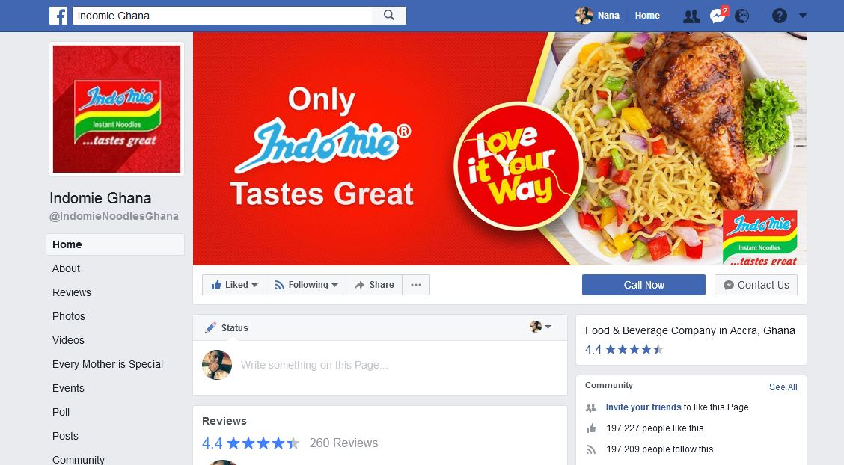
INDOMIE_GHANA FACEBOOK PAGE DYNAMICS

Slide 2

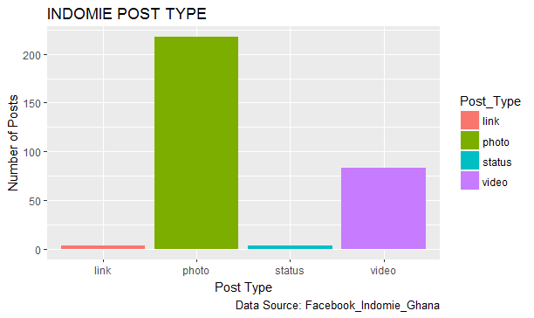
YEAR - 2017
Photo was mostly posted on the page followed by video. Link and Status was least posted on the Indomie_Ghana Page.

Slide 3
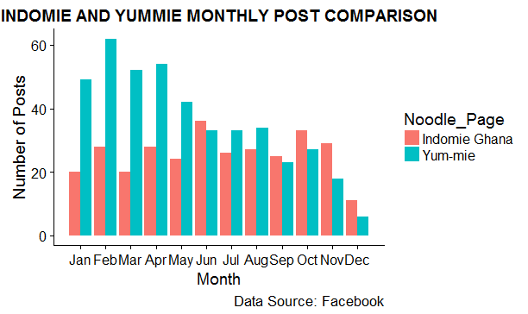
Indomie Ghana page post has stable number of post but yummie has a decreasing trend.

Slide 4
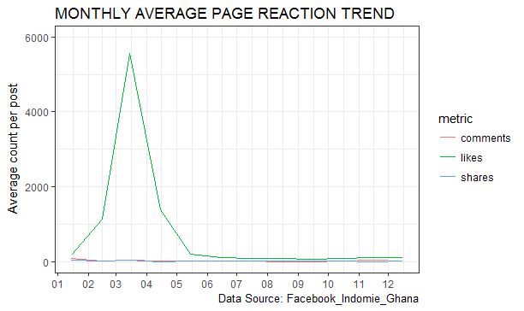
There was high likes count for March and April.
However, likes, shares and comments have been down there after.

Slide 5
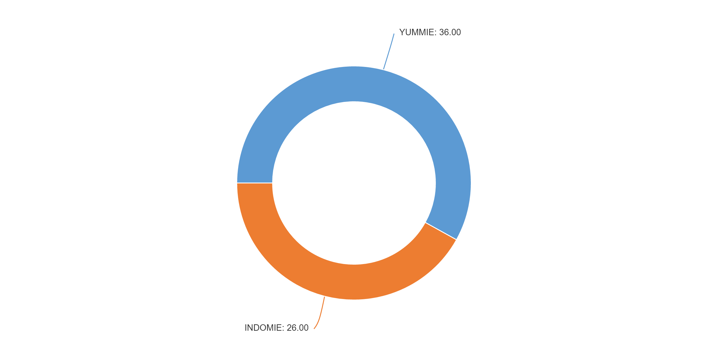
  AVERAGE NUMBER OF POST PER MONTH
Indomie average post per month is 26 whilst that of Yummie is 36.
Yummie is 36/26= 1.34, 1 time likely to post ahead of Indomie.

Slide 6
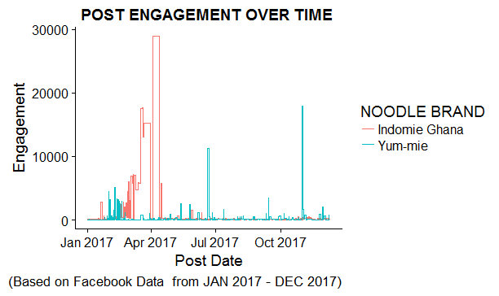
Engagement is the total number of likes, shares and comments per post.
Indomie have achieved much engagement over Yummie, but then Indomie
engagement declined after the month of July 2017

Slide 7
INDOMIE_GHANA POSTS THAT GENERATED MUCH LIKES, SHARES AND COMMENTS
DATE | MESSAGE | LIKE COUNT | COMMENT COUNT | SHARE COUNT
2017-04-03 | Drum roll please! Our winners are:1st Opoku Tikofy Prince ,2nd So Lo Mon ,3rd Abu Bonsra. Please send us a message via inbox to claim your prize! Congratulations to you all. | 28766 | 93 | 41
2017-01-19 | Love the Game? Join #IndomieAfconFie on GTV...GTV SPORT.PREDICT & WIN INDOMIE GOODIES/AIRTIME. SHARE & LIKE POST AS YOU PREDICT. ALSO REMEMBER PREDICTIONS ENDS AFTER KICK OFF. YOU CAN ONLY PARTICIPATE BY JOINING OUR PAGE WITH A CLICK ON THE 'LIKE' BUTTON (Indomie Ghana) | 1194 | 1147 | 416

Slide 8
YUMMIE POSTS THAT GENERATED MUCH LIKES, SHARES AND COMMENTS
DATE | MESSAGE | LIKE COUNT | COMMENT COUNT | SHARE COUNT
2017-11-01 | As sons and daughters of the motherland, we ought to eat what we produce and hold our own in high esteem. #ProudlyGhanaian | 17888 | 44 | 30
2017-11-25 | It's Premier League action today at Anfield as hosts Liverpool FC take on reigning champions Chelsea Football Club. Predict the correct score, share the post, tag five (5) friends and win free airtime. #YummieSharePredictandWin | 529 | 233 | 189

